Slide 1
9/6/24 Meeting

Slide 2
Template: Research Paper (Author)
Technical Approach
Some details and contributions
Main ideas of solution
Challenges/problems:
And limitations
Evaluation methods and results
Source:
Code:
Data:

Slide 3
EtWE (Raff et al)
Convolutional Neural Net
8D embedding
Standard Keras convolution cross-mult with sigmoid of standard conv
Max pool -> Single Hidden Layer -> Softmax output
Use convolution to scale .EXE length to a much smaller input layer
Challenges/problems:
Group A (Virusshare) trains “from Microsoft” rather than “benign”
Vulnerable to evasion-- 60% rate (Gopinath M. et al, pg 23)
Standard Holdout Cross-Validation: Avg. Acc: 90.6%
Source:
Code: GitHub
Data: https://virusshare.com/ (available) and OpenMalware (site shut down)
Additionally a “larger training corpus” from “the original company” (pg 3) is not specified

Slide 4
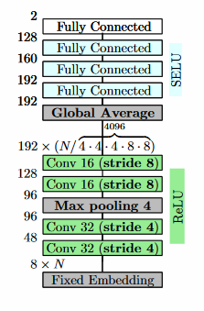
“Deep Conv…Learn from Raw Exe…” (Marek Krčál et al)
Convolutional Neural Net
8D embedding again
Improvements over MalConv:
Multiple N²-stride-length convolutions
SELU activations
Removed DeCov regularization
Larger dataset
Challenges/problems:
“...lack of an industrial-sized publicly available datasets.” (pg 2)
Feature Evaluation using handcrafted and enriched features (by malware analysts at Avast) in a Feedforward Network: 96.0∓0.6% Accuracy
Source:
Code: 3rd party reproduction
Data: Avast

Slide 5
“MalDAE:…Malware based on correlation…” (Weijie et al)
Multi-Model Suite for detection and classification
Random Forest, Decision Tree, K-nearest neighbor, XGBoost
Fusion of static and dynamic analysis using API calls
Dynamic analysis in Cuckoo Sandbox
Challenges/problems:
Excess noise and redundant calls to avoid detection
API call sequence changes to avoid detection
Cross-Validation; Detect Avg. Acc.: 97.63%, Classify Avg. Acc.: 90.35%
Source:
Code: N/A
Data: VirusShare

Slide 6
“...malware detection using audio signal…” (Farrokhmanesh et al)
Standard Classification models adapted for audio input
KNN, AdaBoost, Random Forest
Encode binary as waveform audio as embedding
Circumvents feature extraction and reduces memory cost
Challenges/problems:
Limited by data pre-processing
Cross-Validation; Avg. Acc.: 91.4%
Source:
Code: mentions “pyAudioAnalysis library” but model code N/A
Data:
Malware Dataset from VxHeaven (Website Shut Down)
Benign files selected from original Windows XP files and other utility software

Slide 7
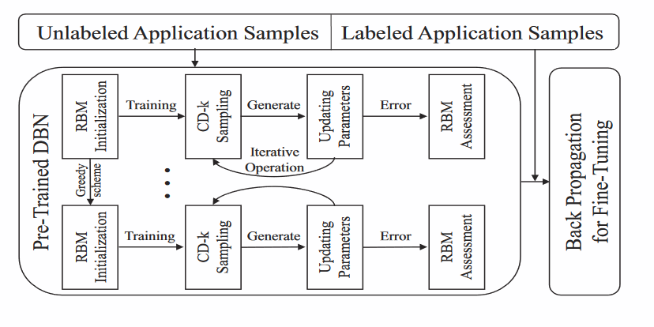
“Droid-Sec: deep…android malware…” (Yuan et al)
Deep Learning Model
Unsupervised pre-training
Supervised back-propagation
Android Apps’ .apk files contain app permissions
Text-parsable files with all system functions the app can access
Combined with dynamic analysis to extract 200 features
Challenges/problems:
Small dataset size
Cross-Evaluation: 96.5% Accuracy
Source:
Code: Website Shut Down (http://www.droid-sec.com)
Data:
Malware set (250 samples) from Contagio Mobile
Benign set crawled from the top 250 apps in the Google Play Store

Slide 8
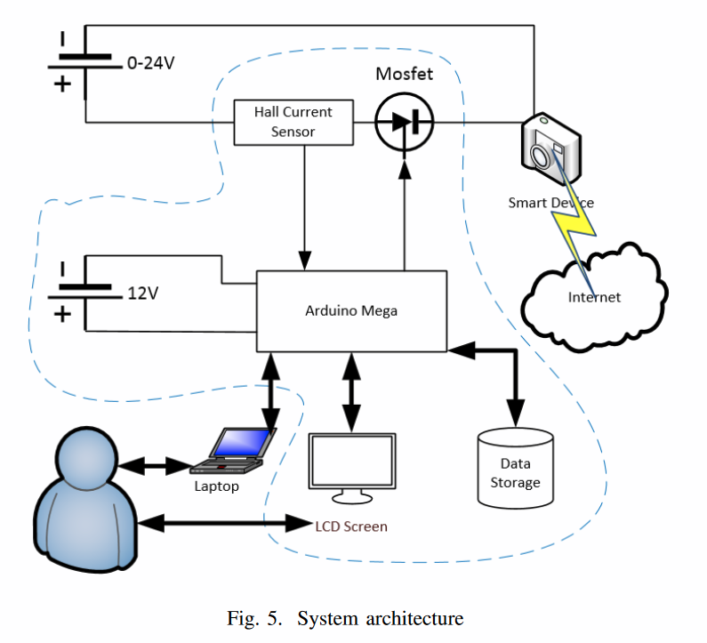
“ML Clustering…for intrusion detection to IoT…” (Papafotikas et al)
K-Means Clustering on Power Draw Values
Arduino based circuit (see Fig. 5) →
Normal operation of IoT devices has a predictable power range
Challenges/problems:
Does not detect logical network attack or packet masking
Attacks can be disguised to respect operating conditions
Penetration Testing: 100% Accuracy
Source:
Code: N/A
Data: Self-Generated

Slide 9
What is My Role as a Research Assistant?
Is it your research which I am assisting you with?
Do you have a larger plan that you could explain to me?
Right now, I’m following your instructions until the next meeting but I cannot see past that meeting.
Source of uncertainty and doubt
Or are you guiding me along until I find a research path for myself?
Are you waiting for me to propose a definite research topic?
Or is there more that you want me to do before then?

Slide 10
Proposal for Research Direction
Working Title: “A Survey and Analysis of Publicly-Available Malware Datasets and their Applications in Machine Learning Detection Models”
Locate and download all possible malware datasets
33.33% ideal of each of Windows, Mac and Linux
Perform Data Analysis on bytecode and extracted system API calls
Histograms, Bar Graphs, etc.
Train and test models using each dataset and cross reference scores between models and datasets
Ideally when the models’ authors have code provided, but I can implement models myself where needed

Slide 11
One Last Thing
I doubt the usefulness of meeting twice in one week.
The one and a half days I have between Wednesday’s meeting and Friday’s is not enough time to get a meaningful amount of work done (by my own standards)
Or less time, if you email me on Thursday with a task for me.
I think the only case in which two meetings is useful is when we need more time to discuss topics we were already discussing during the Wednesday meeting.

